Slide 1


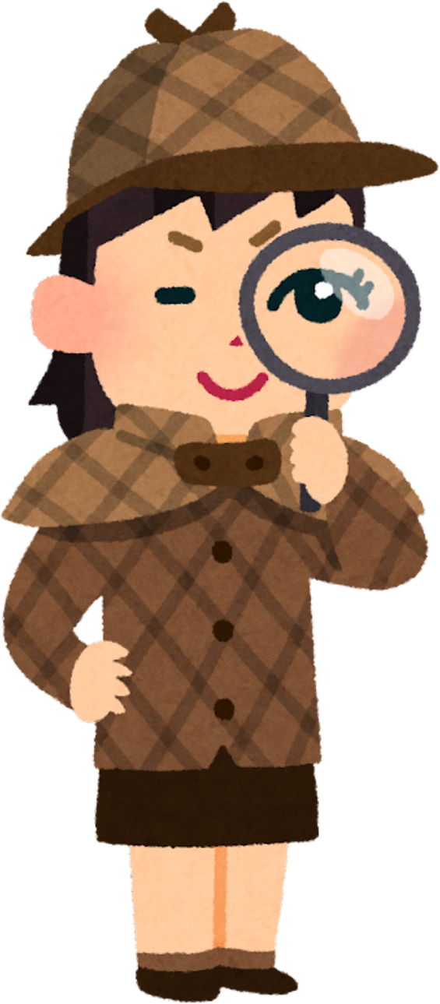
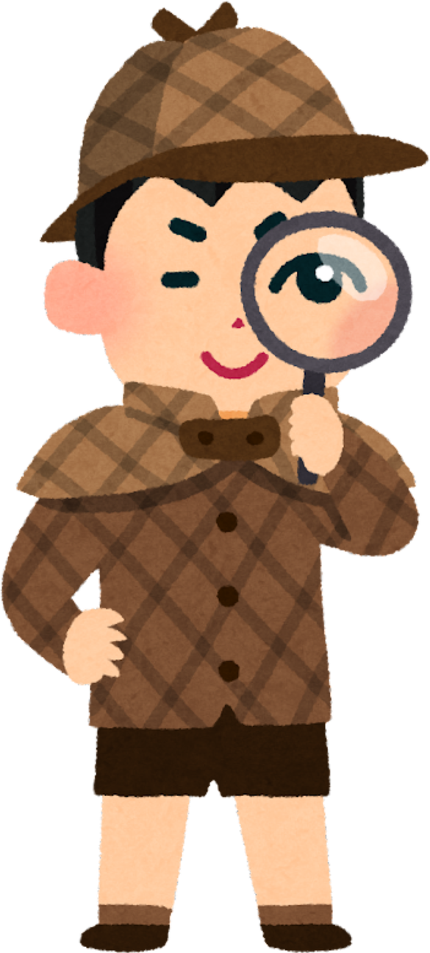





Forest Detectives
What happened to the forest ?

Slide 2

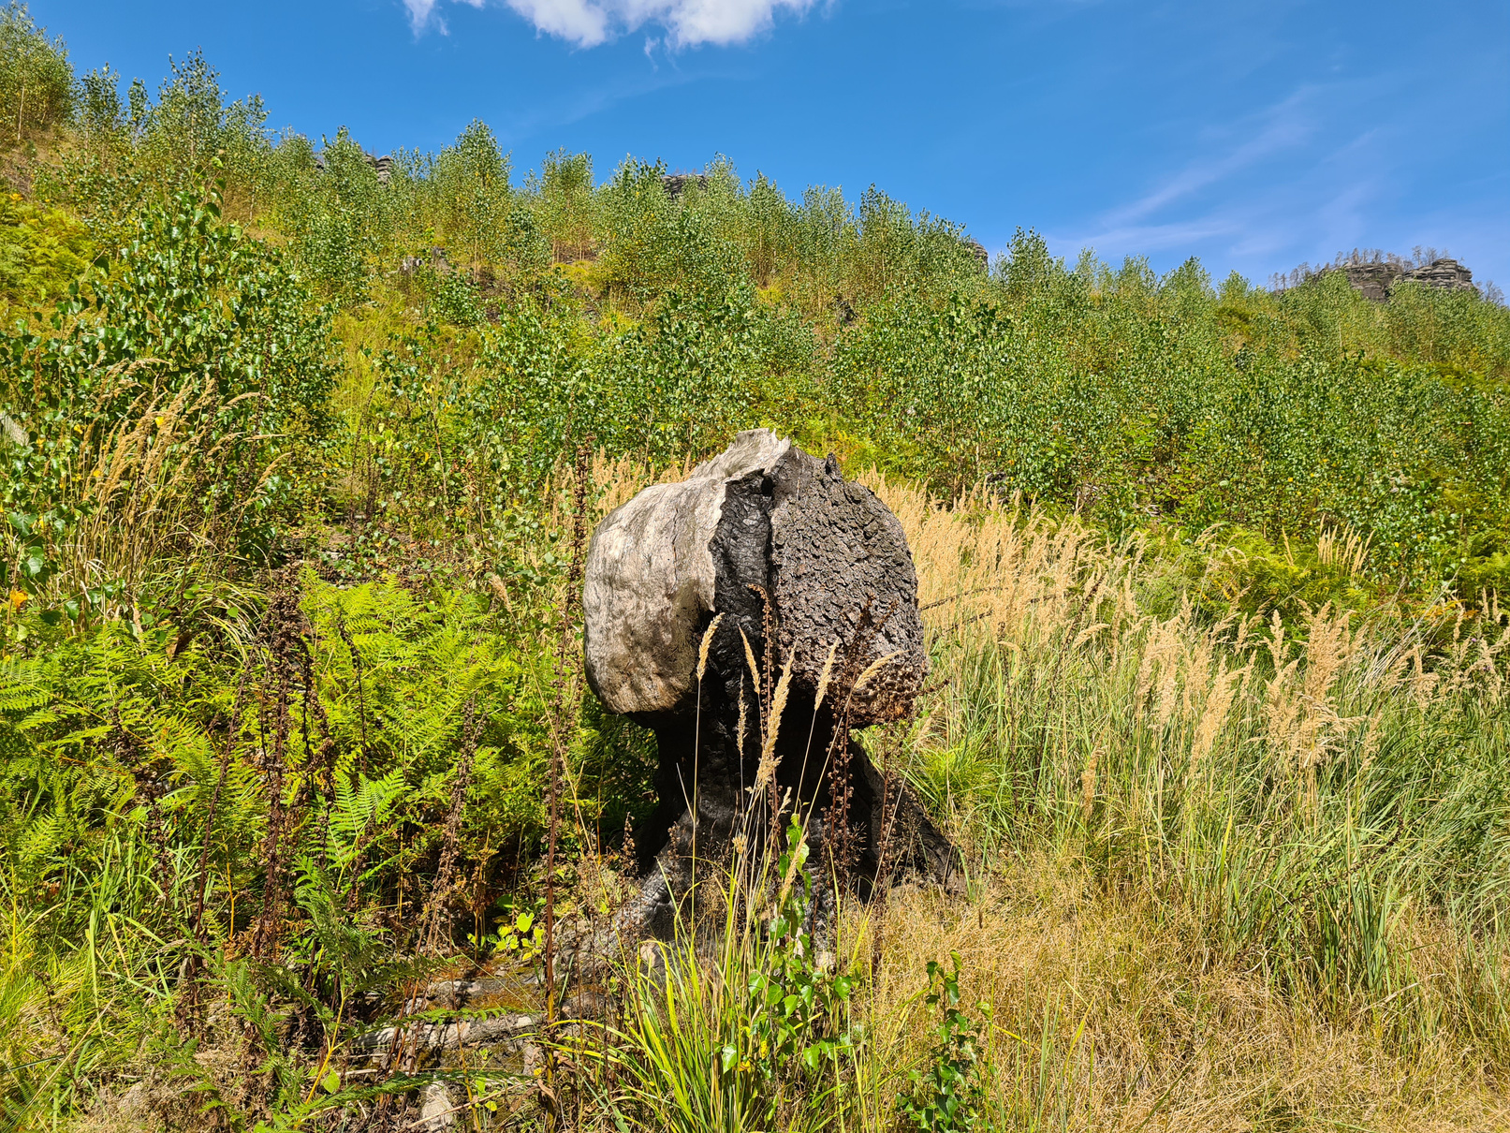
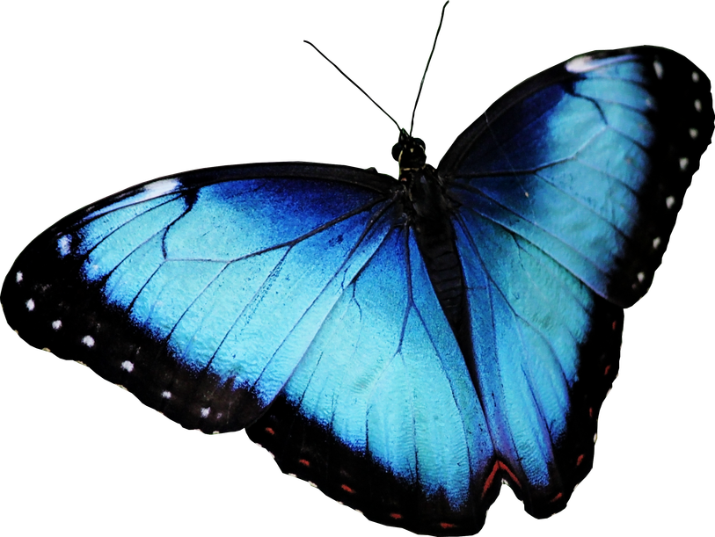
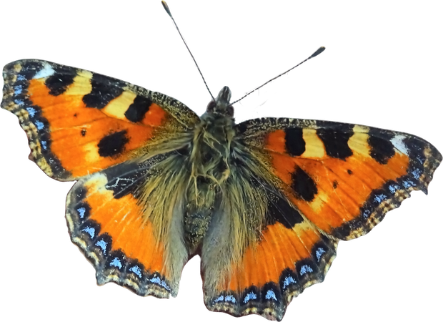
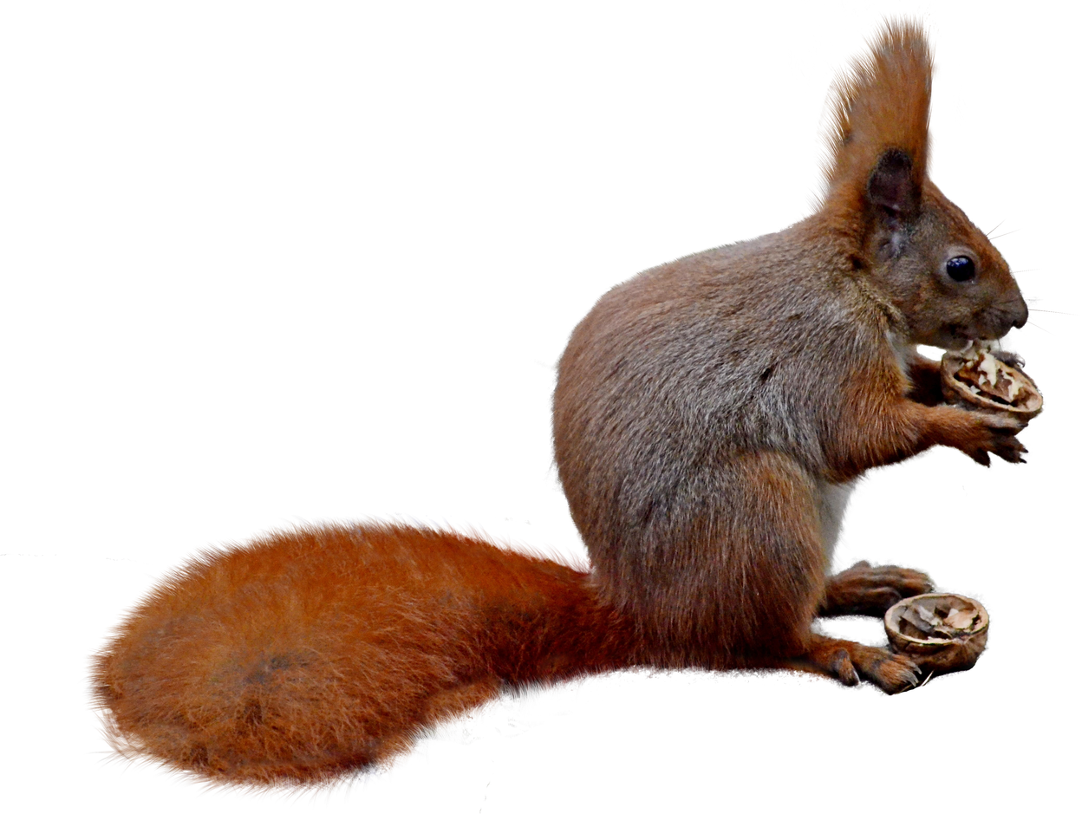
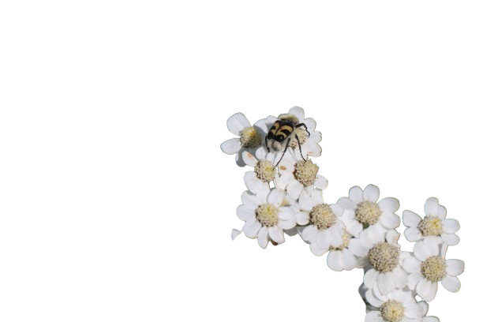
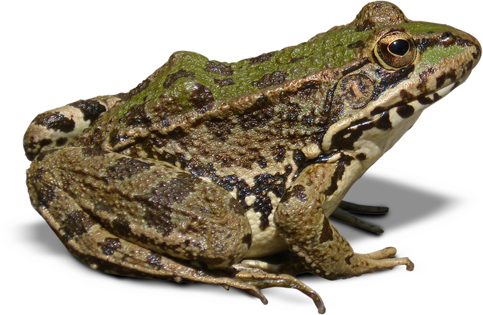
A - 2021
A healthy, living forest
© Lucie Červená

Slide 3
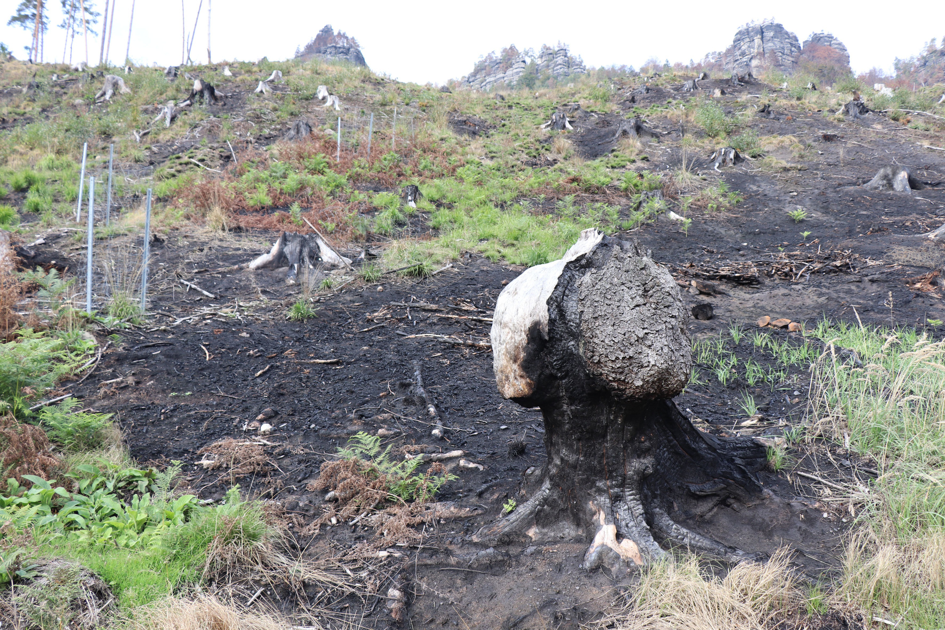
B - 2022
A fire destroyed the forest
© Lucie Červená

Slide 4
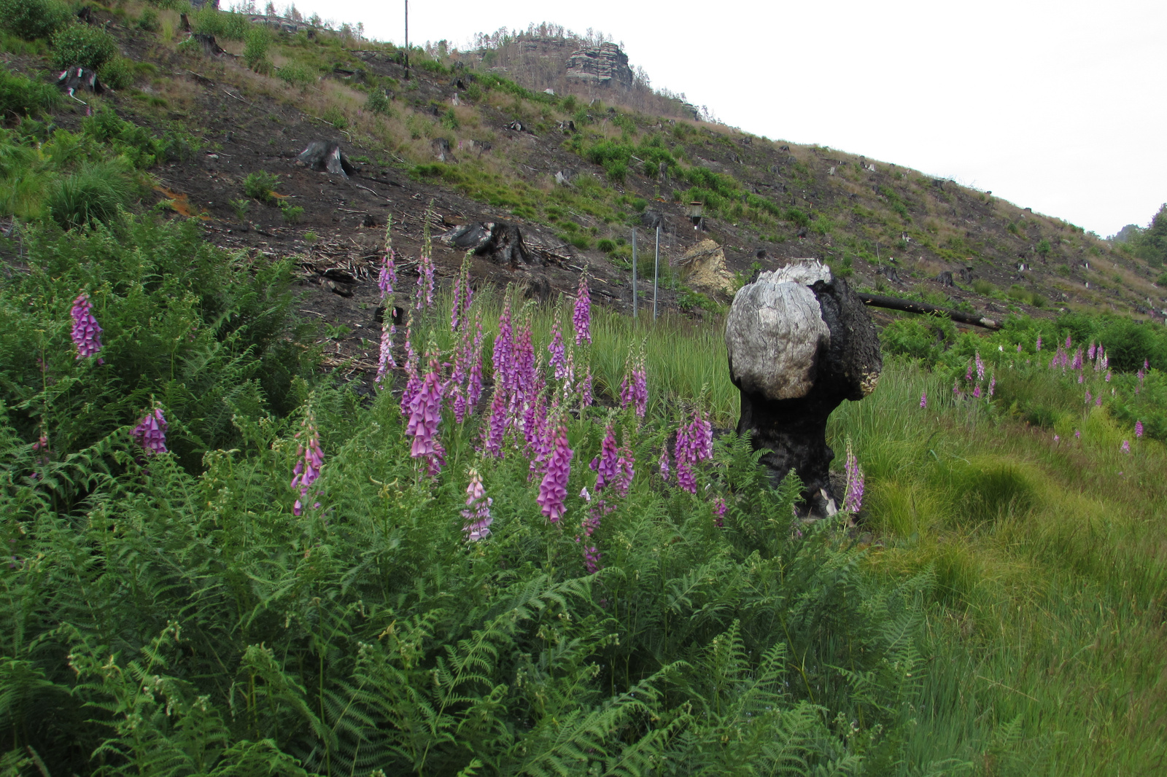
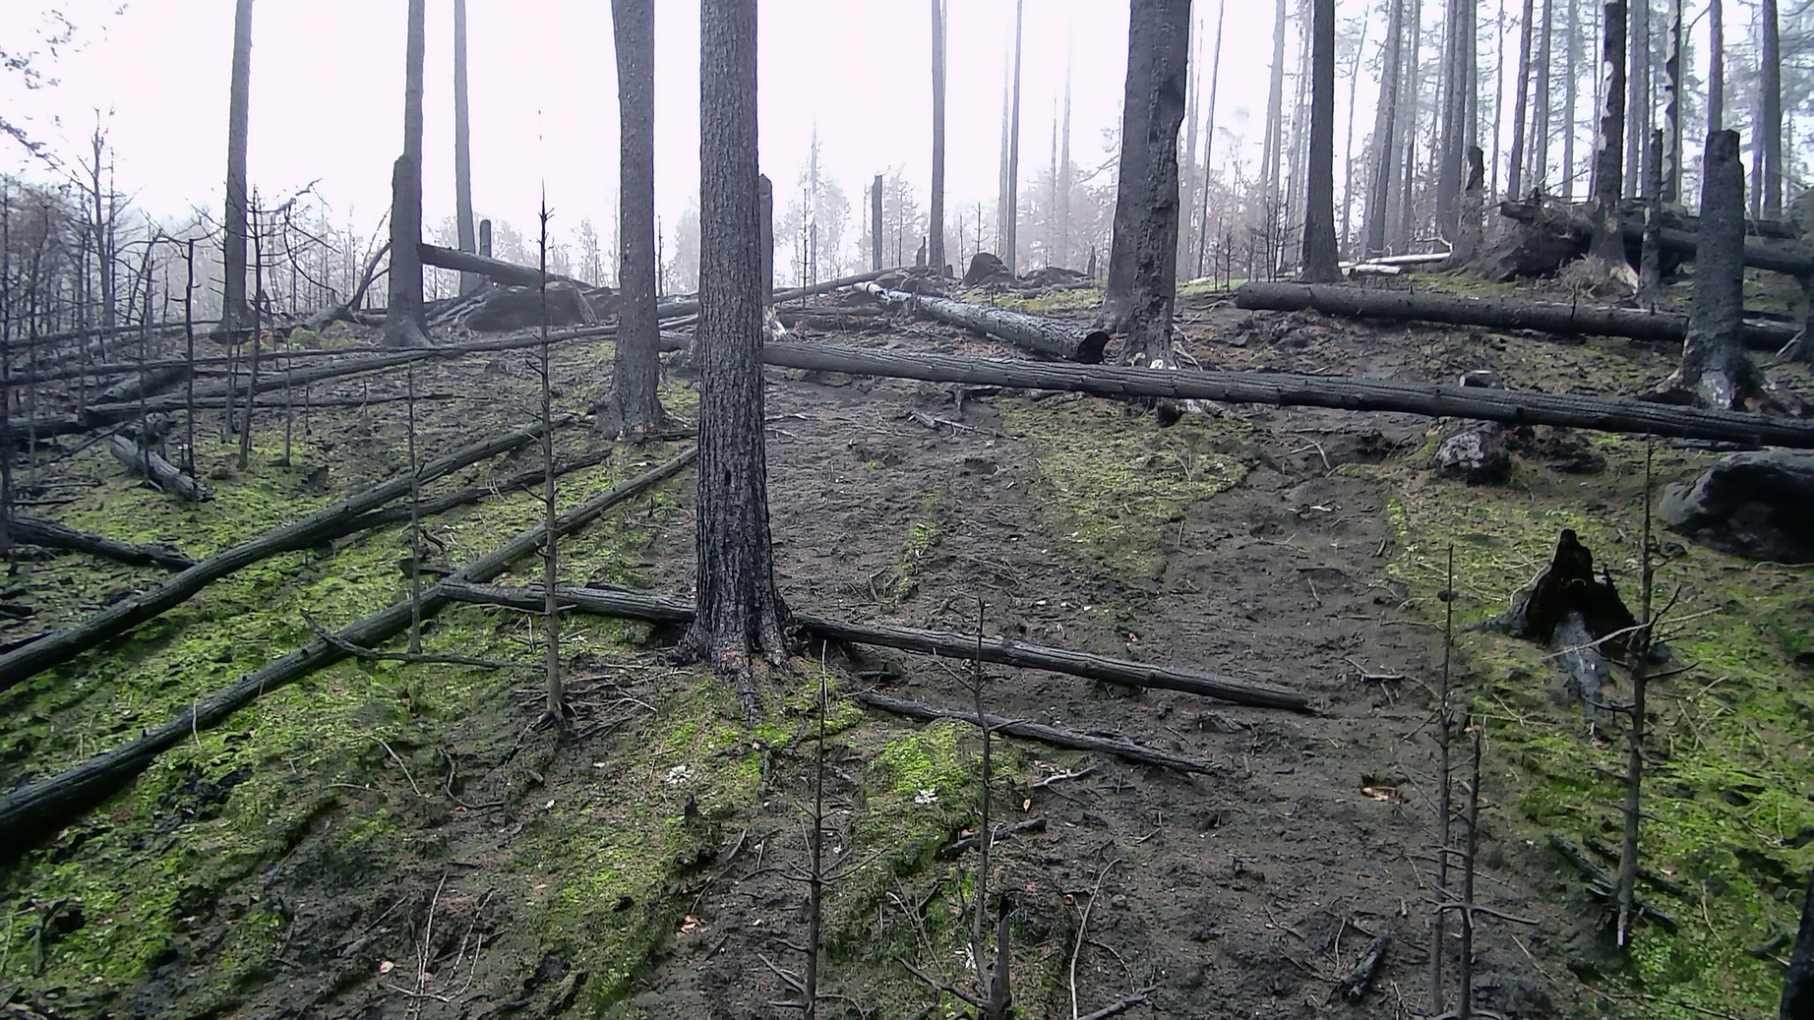
C - 2023
After the fire: only a few plants
© Anette Eltner
© Lucie Červená

Slide 5
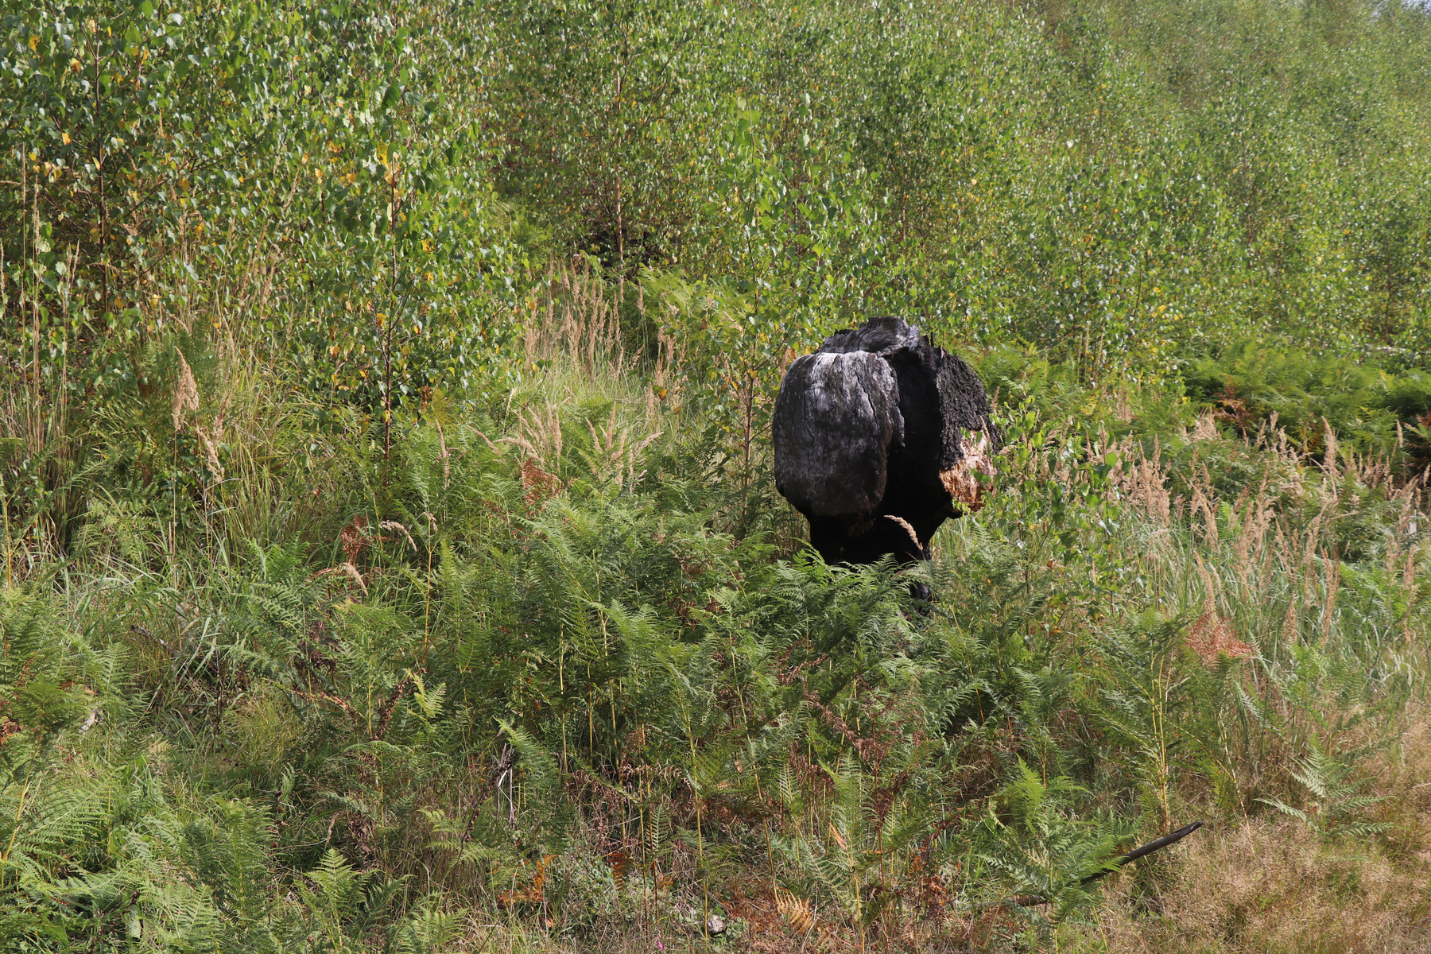
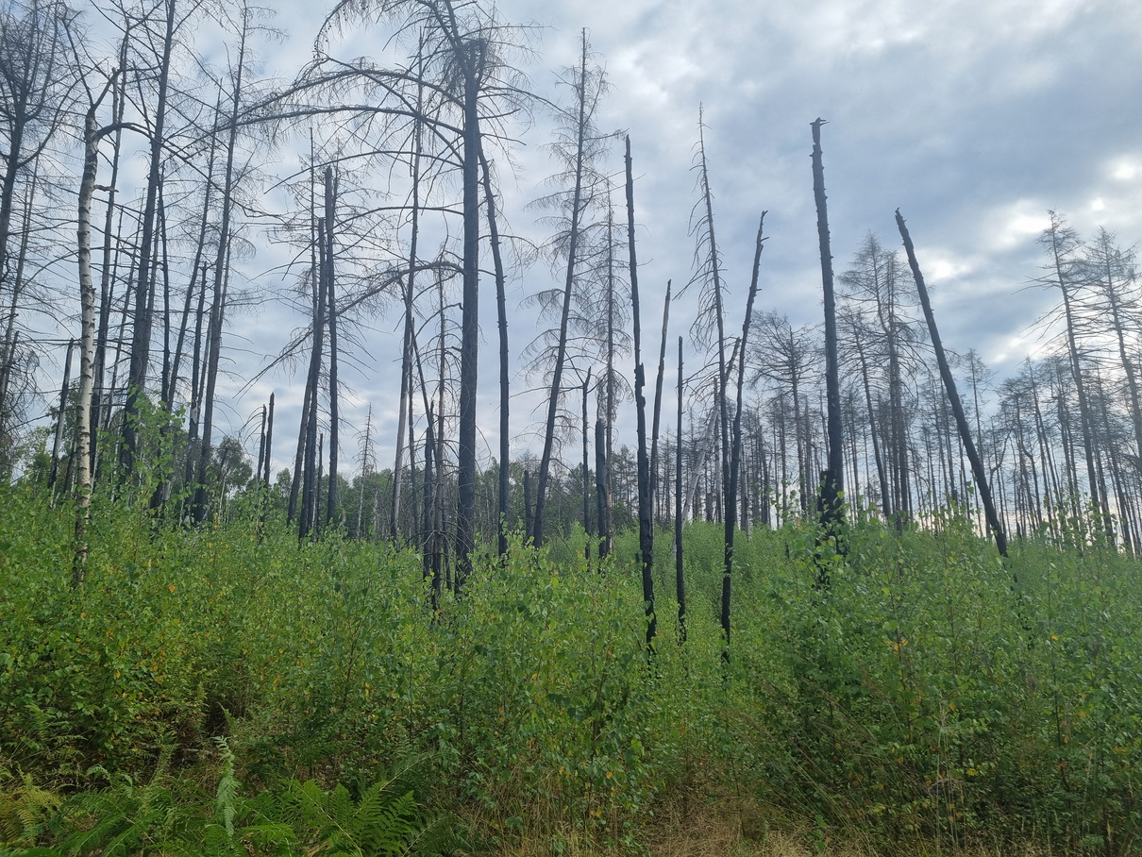
D - 2024
Nature slowly comes back
© Carolin Rünger
© Lucie Červená

Slide 6
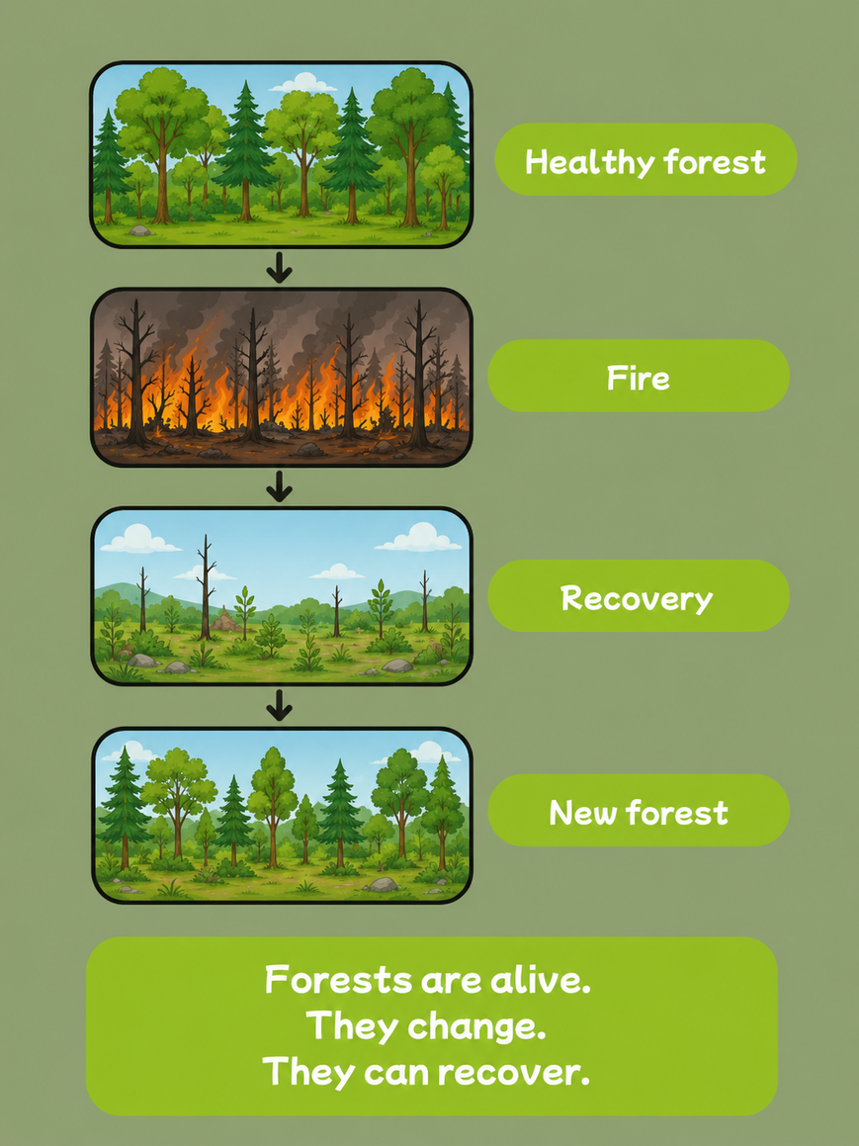

Check the story

Slide 7
Thank you, Forest Detectives!
Thank you for helping me tell my story.

