Slide 1
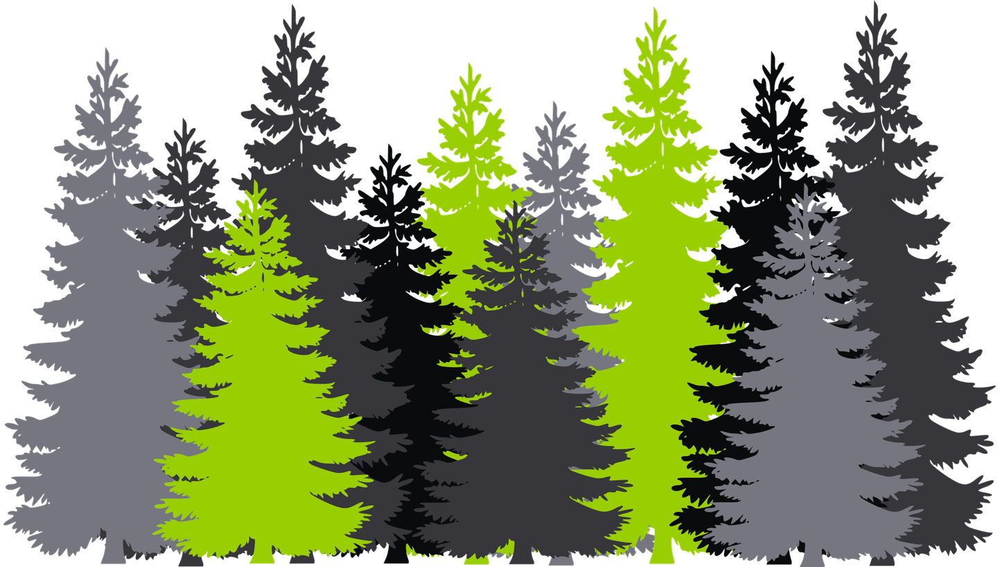
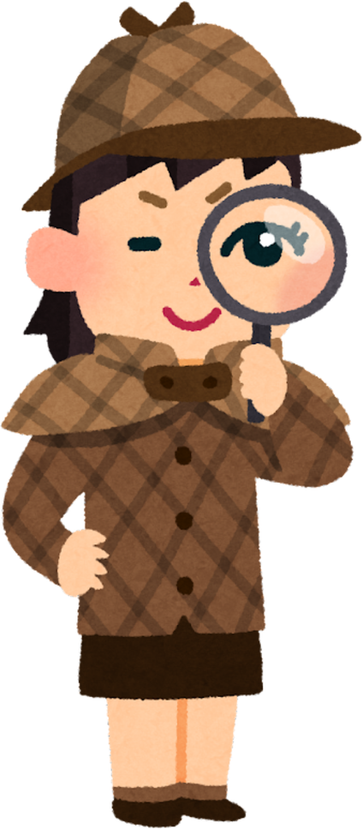
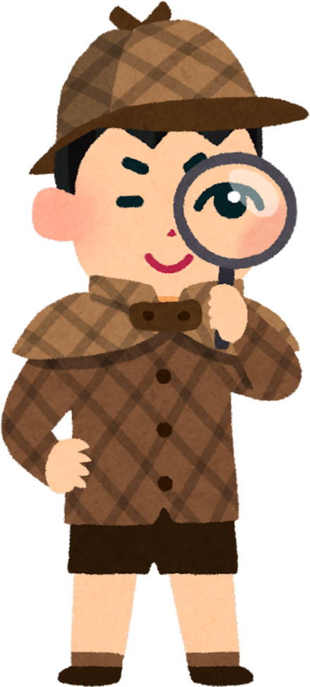





Forest Detectives
What happened to the forest ?

Slide 2

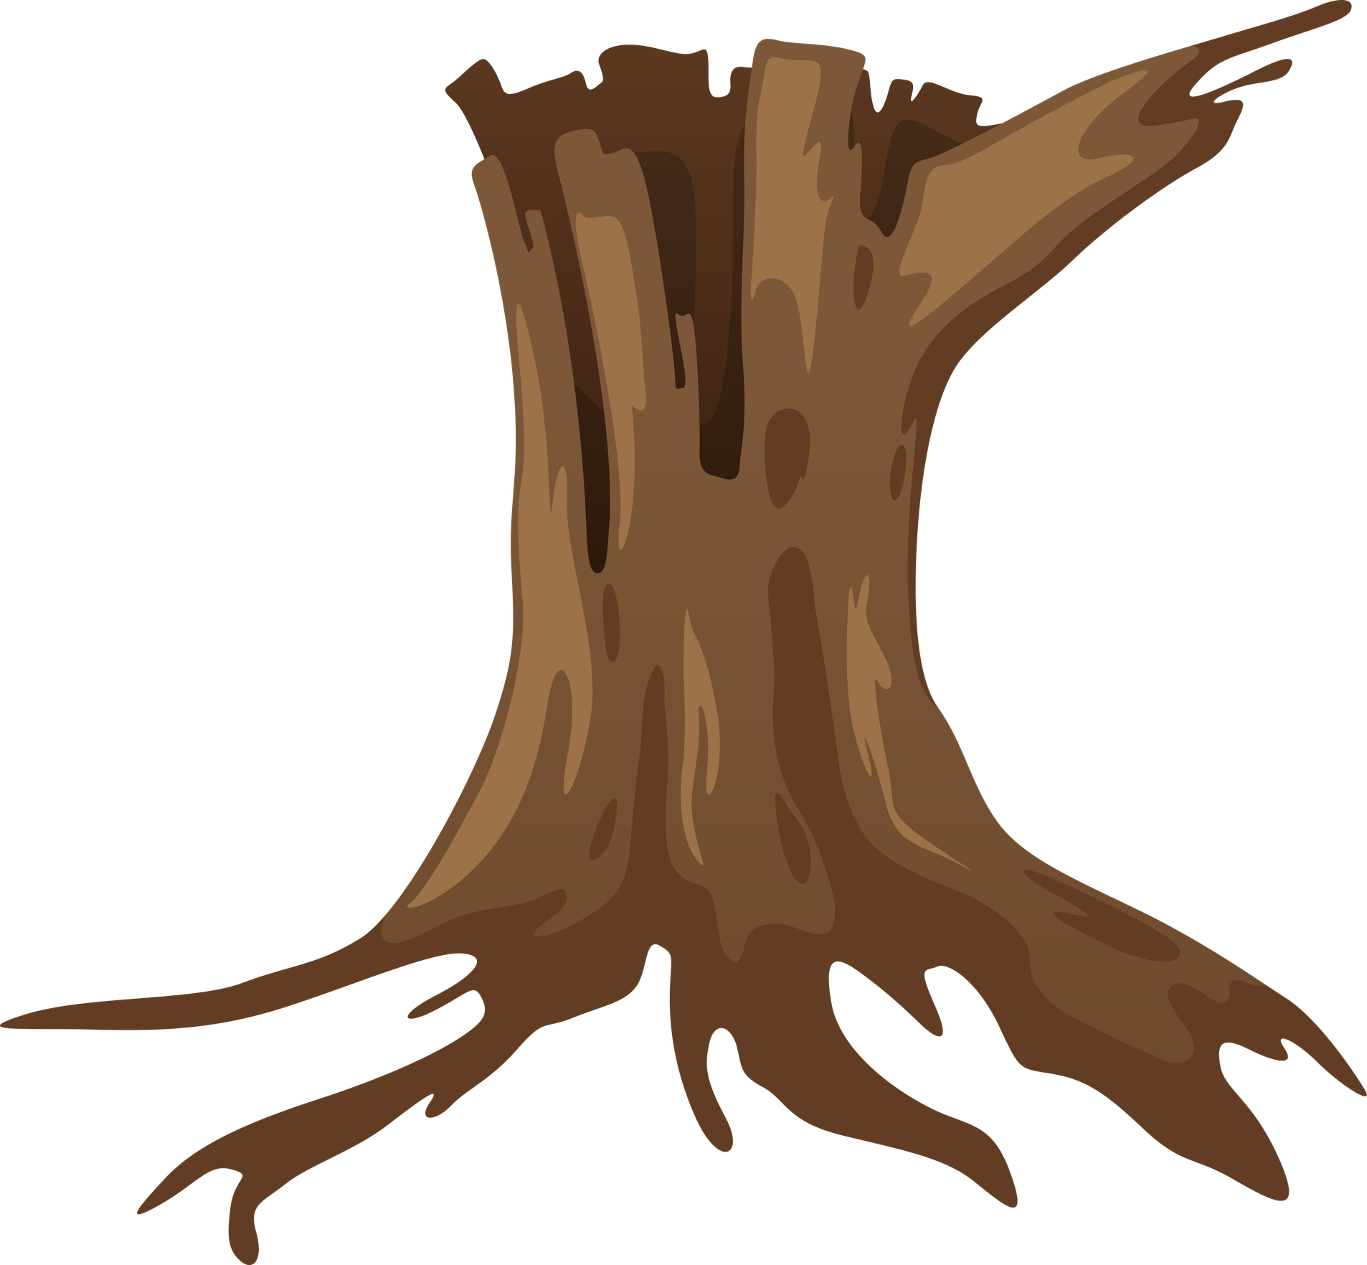


1
Key words
FOREST
2
TREE STUMP
Vocabulary we will need today
3
PLANT
4
GROUND
5
FIRE

Slide 3
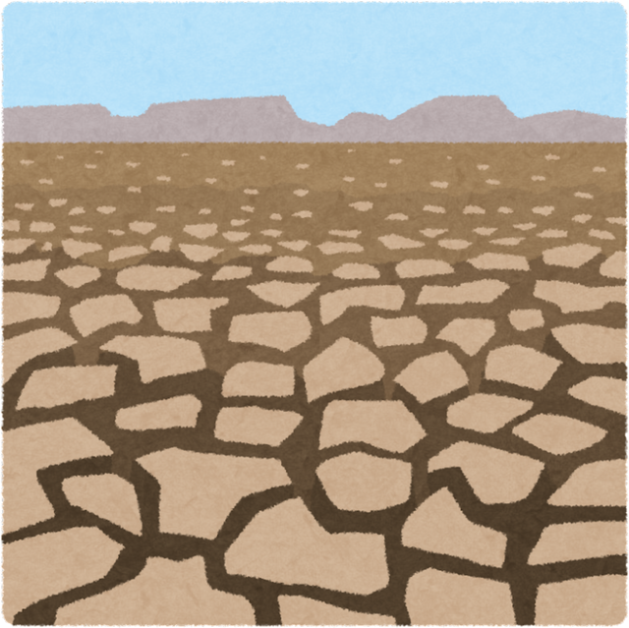
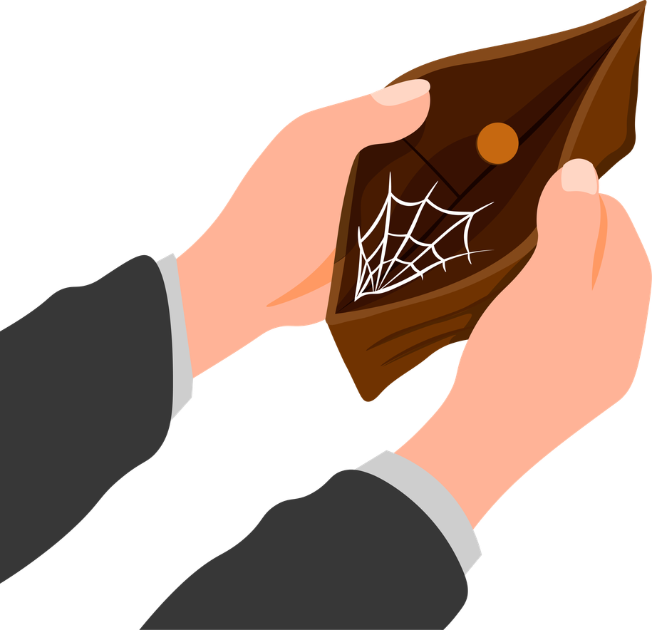
6
Key words
SMOKE
7
SPREAD
Vocabulary we will need today
8
DRY
9
BURNT SOIL
10
EMPTY

Slide 4
Key words
1
2
3
4
Let’s remember the words
5
6
7
8
9
10

Slide 5
Meeting the tree stump
I was once a big, strong tree.
I stood in the middle of the forest.
But one day the forest changed.
It became dry and hot.
My wood become soft.
One day I fell down.
Today I'm a tree stump.
  What do you think happened in this forest?
  How might the story continue?

Slide 6
Become Forest Detectives
Now it's your turn to become Forest Detectives!
  Work together in groups.
  Look carefully at the pictures.
  What can you see?
  Put the cards in the order you think is correct.

Slide 7
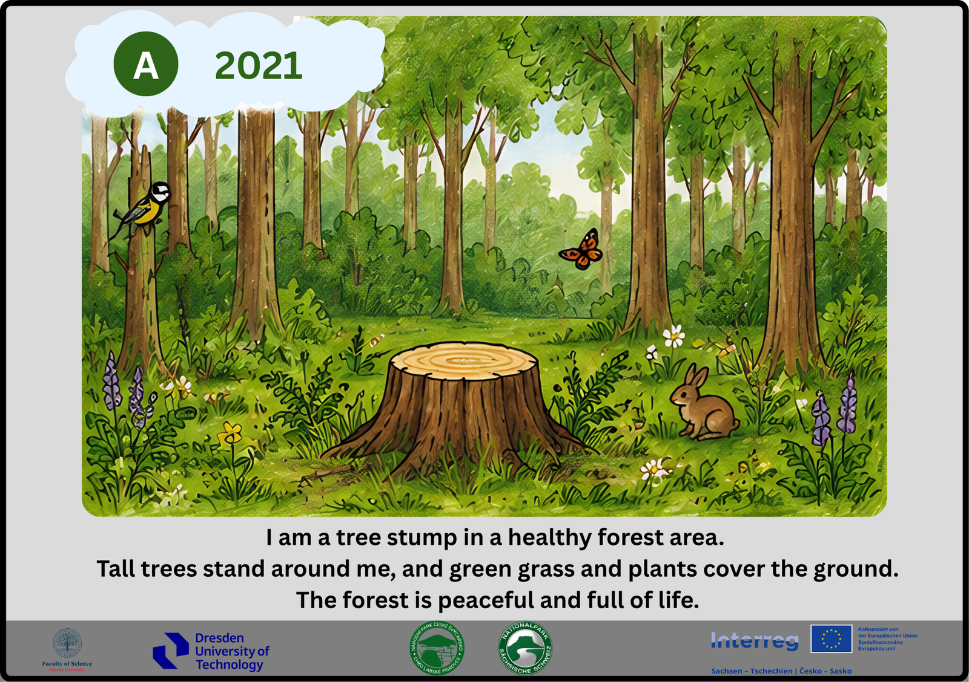
A healthy forest

Slide 8
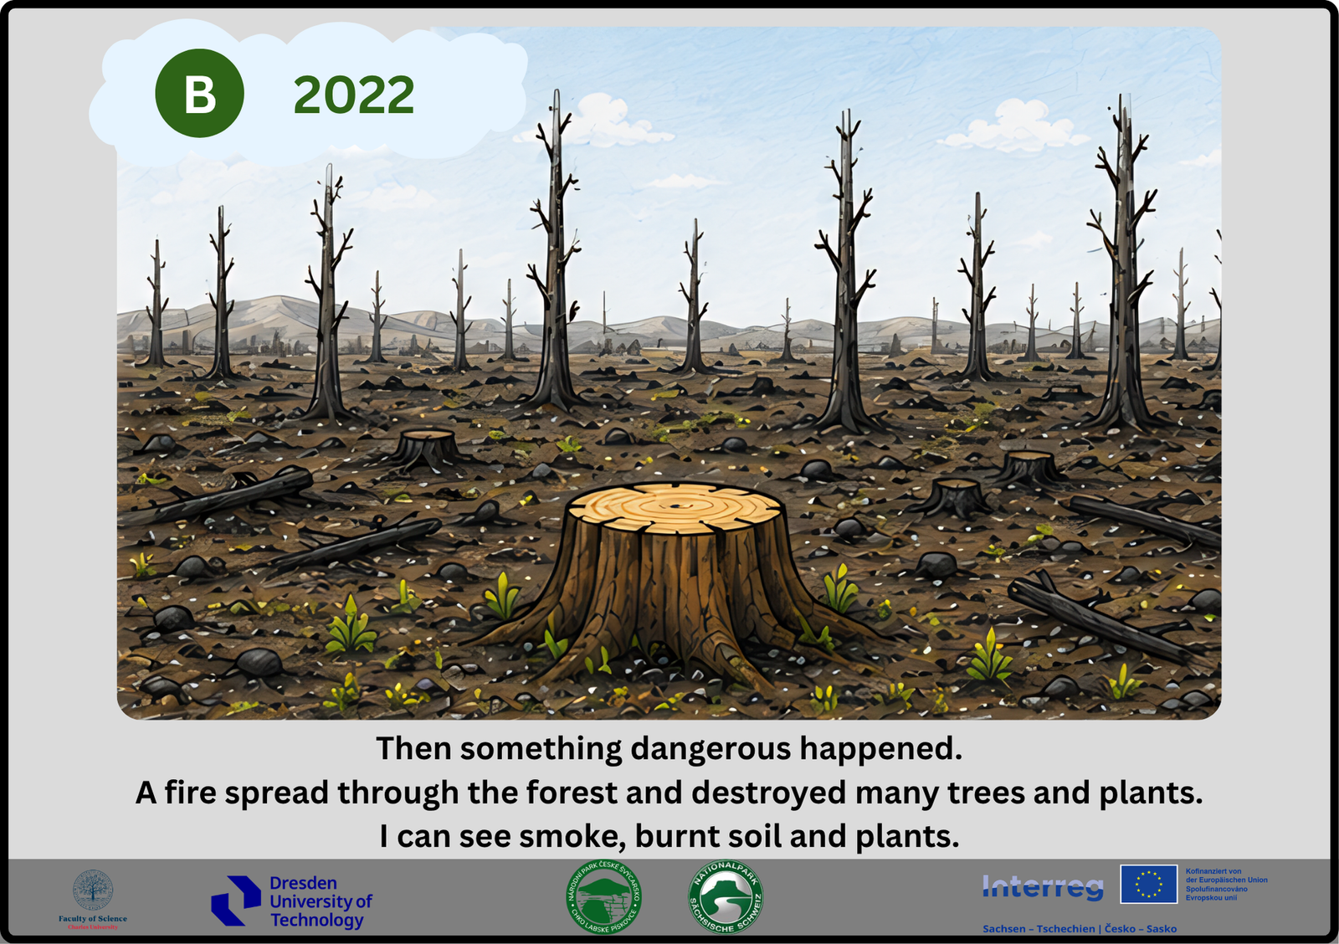
The fire

Slide 9
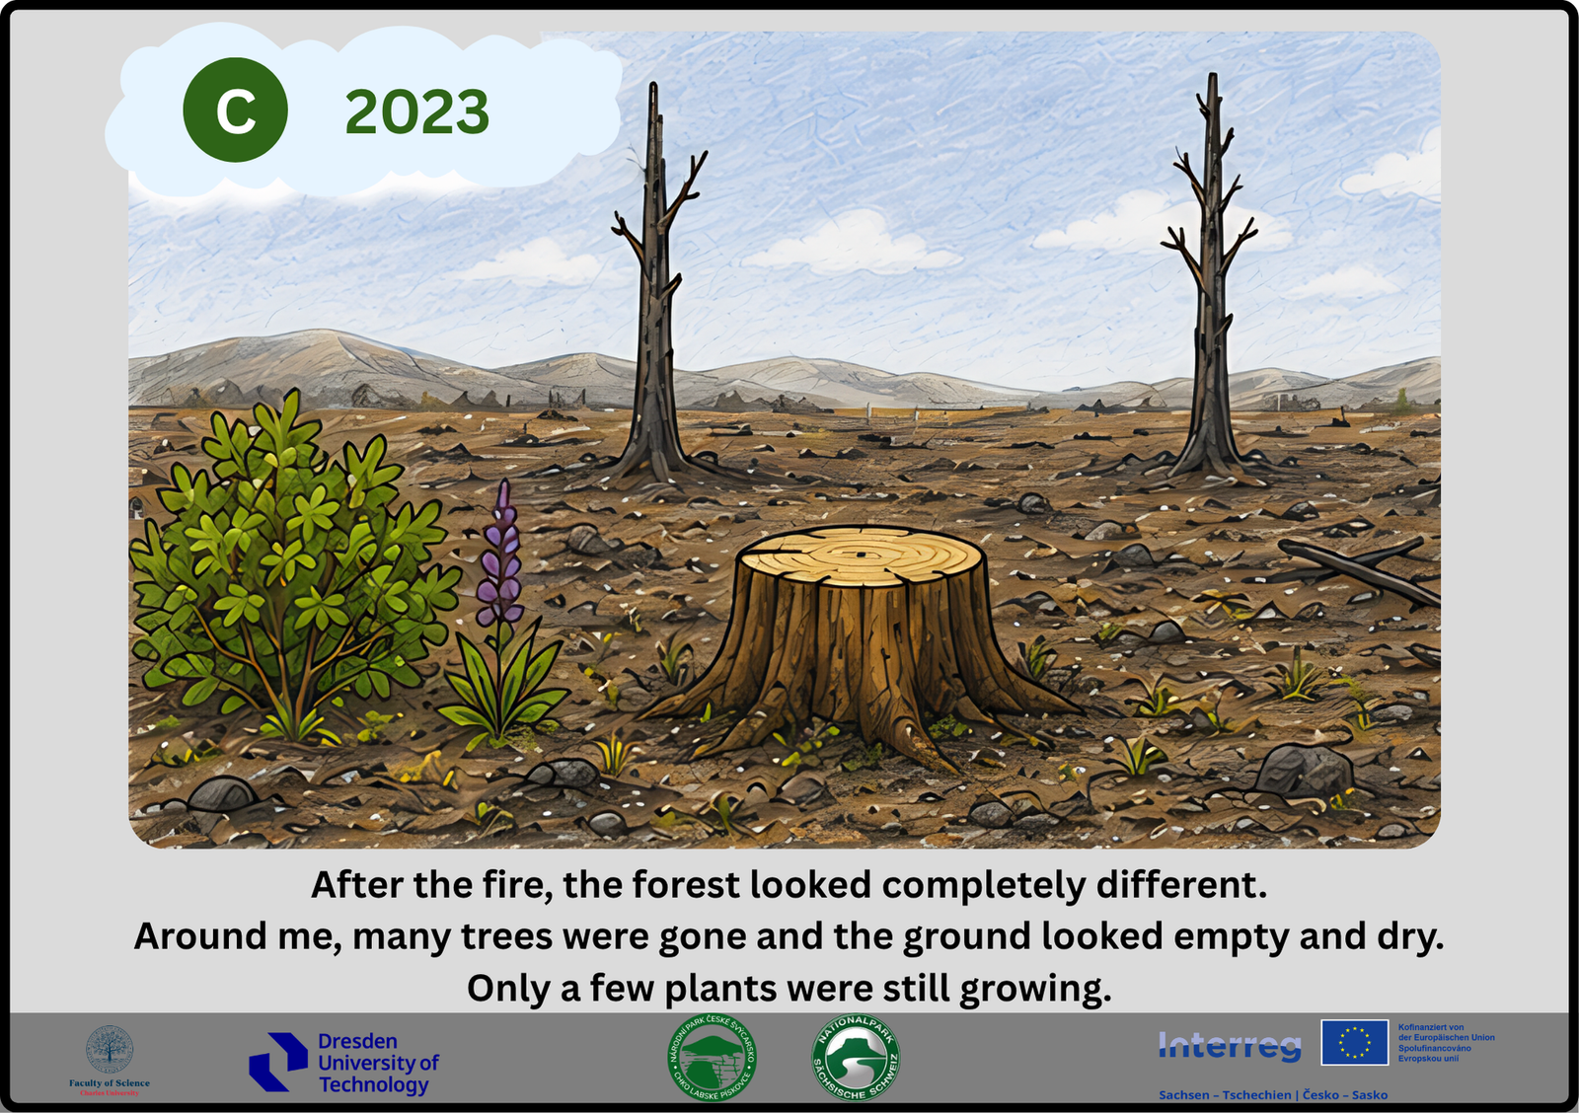
The fire

Slide 10
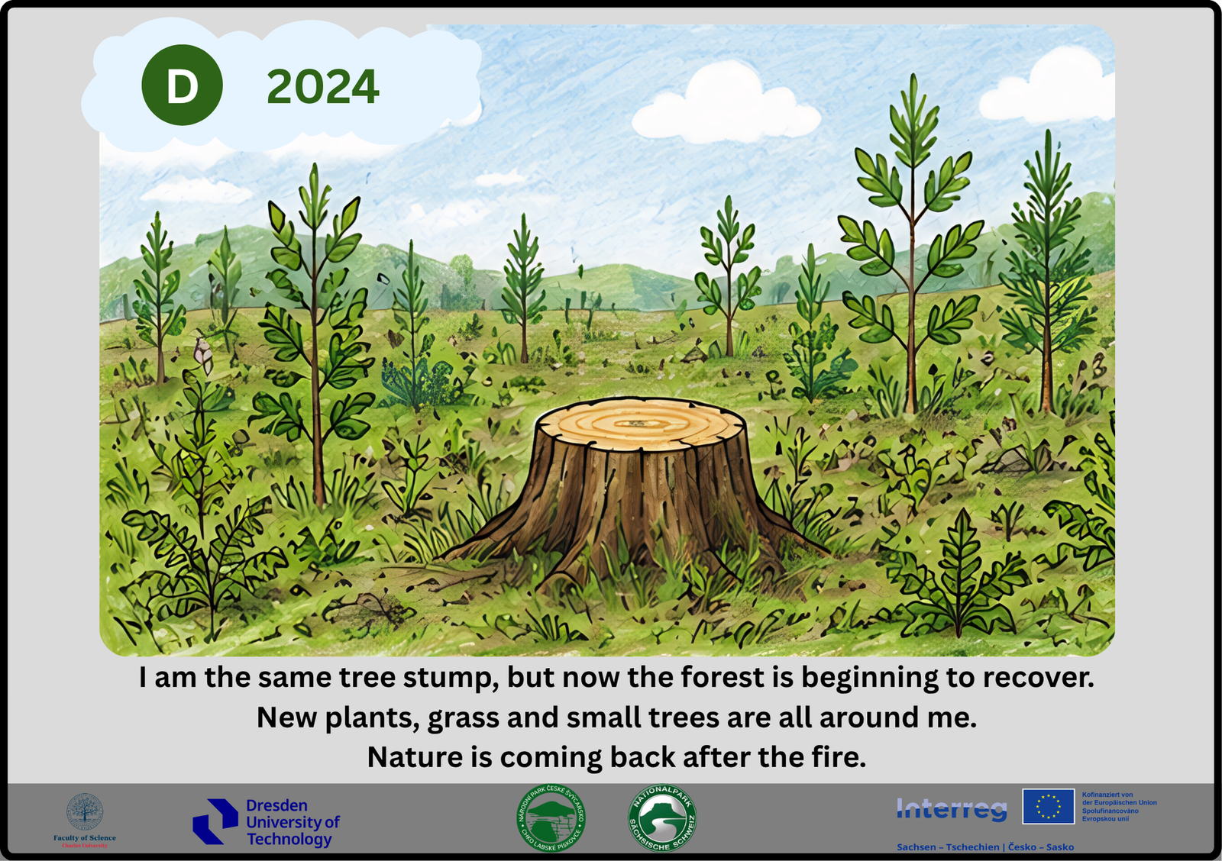
The fire

Slide 11
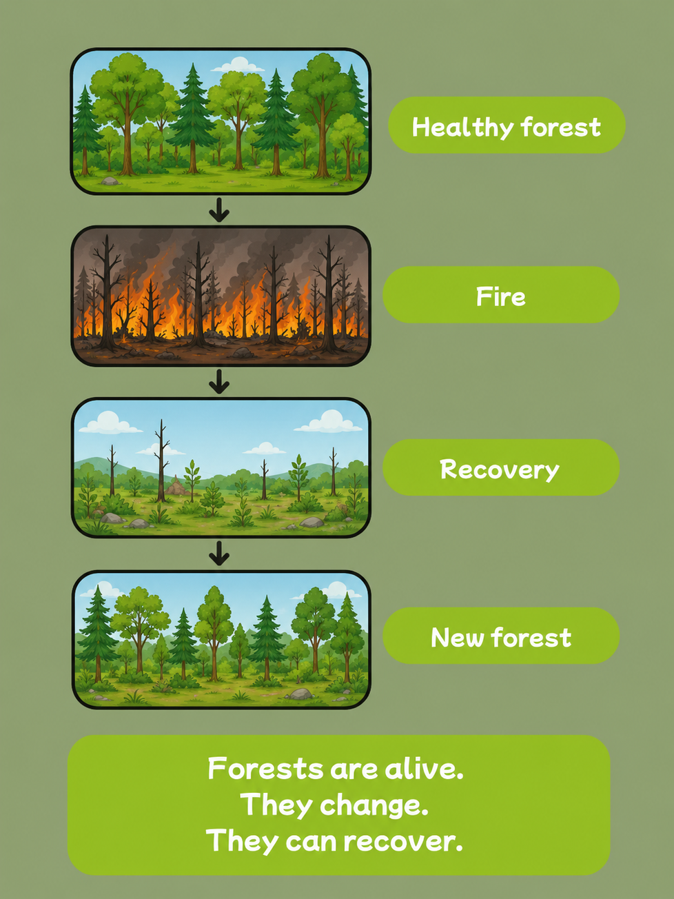
Check the story

Slide 12
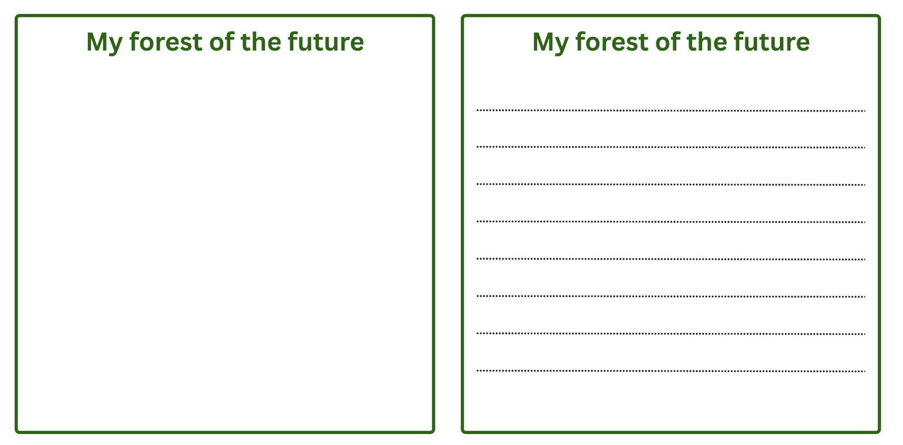
Imagine the future
Draw you future forest
what will forest look like in the future?

Slide 13
Thank you, Forest Detectives!
Thank you for helping me tell my story.

